Slide 1
WEATHER PREDICTION USING CNN
Presented by:
GOKUL RAGHAVENDRA.V
III year ,AI & DS
COLLEGE-KVCET
NM ID-au421221243007
Email ID- GOKULRAGHAVENDRA63@gmail.com

Slide 2
PROPOSED SYSTEM
The project employs Convolutional Neural Networks (CNN) to forecast weather accurately. By analyzing vast data sets, it enhances prediction precision, aiding in disaster preparedness and resource management. Experience cutting-edge meteorological forecasting with CNN-powered solution.

Slide 3
PROBLEM STATEMENT
Enhancing Weather Forecasting with CNNs: Harnessing the power of Convolutional Neural Networks (CNNs) to revolutionize weather prediction. By processing vast datasets, CNNs discern intricate spatial patterns in meteorological data, facilitating precise short and long-term forecasts. Empowering industries with improved predictive capabilities for informed decision-making.

Slide 4
PROPOSED SOLUTION
Proposed solution leverages Convolutional Neural Networks (CNNs) to revolutionize weather prediction. Through deep learning, CNNs analyze intricate weather patterns from diverse data sources, enabling precise forecasts. By integrating advanced technology into meteorology, we provide actionable insights for industries reliant on weather data, fostering resilience and strategic planning. Embrace the future of weather forecasting with our CNN-powered solution.

Slide 5
SYSTEM APPROACH
Hardware
Processor: Intel Core i5 or equivalent (recommended)
RAM: 8 GB or more (recommended)
Storage: Sufficient space to store your data and software
Software
Python (programming language)
TensorFlow (machine learning library)
Keras (deep learning library)
NumPy (numerical computing library)
Pandas (data analysis library)
Matplotlib (plotting library)

Slide 6
ALGORITHM AND DEPLOYMENT
Algorithm Selection: Convolutional Neural Network (CNN) chosen for its ability to extract spatial features from weather data.
Data Exploration: Analyzed historical weather data to understand patterns and correlations.
Problem Formulation: Formulated weather prediction as a regression problem, predicting future weather conditions based on historical data.
Deployment: Deployed CNN model on cloud infrastructure for real-time weather prediction

Slide 7
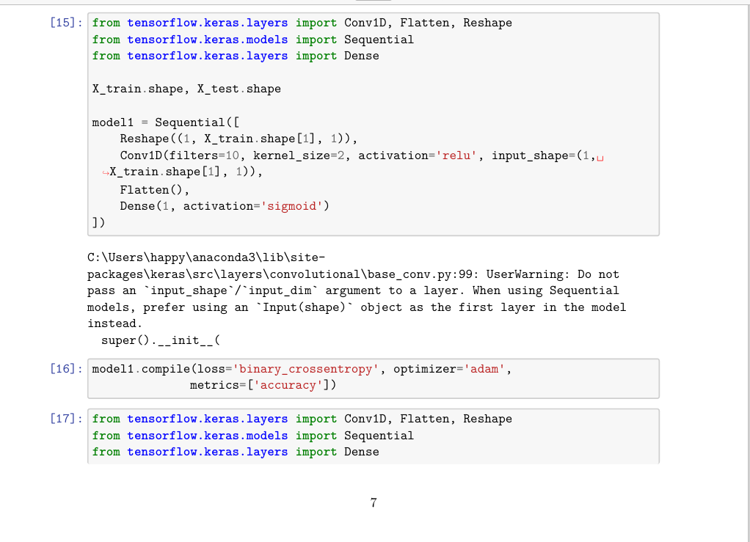
TRAINING AND PROCESS
Data splitting using train_test_split
Feature scaling using the MinMaxscaler
Model training using Convolutional Neural Network (CNN) which Utilize convolutional layers to extract spatial patterns from input data.
Incorporate pooling layers to reduce spatial dimensions and retain essential information.
Add fully connected layers for classification/regression.

Slide 8
PREDICTION PROCESS
New data input from Sources of weather data (satellites, weather stations, etc.)
Preprocessing data using data cleaning, normalization, and augmentation.
Performing the Model Inference on pre processed data
Output prediction results for further action

Slide 9
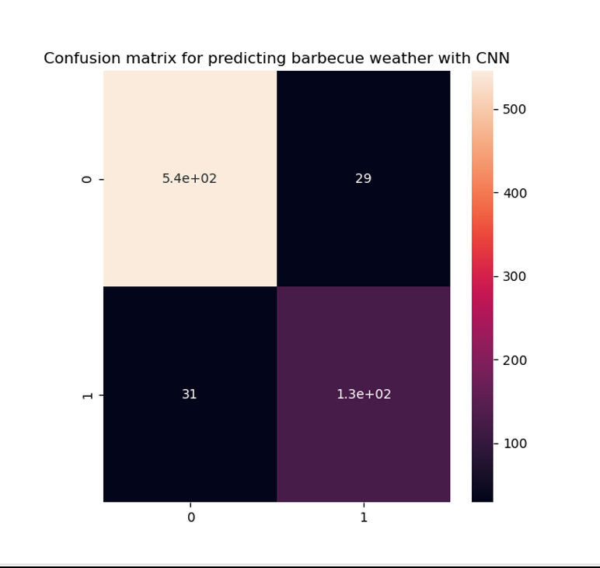
RESULT

Slide 10
CONCLUSION
Utilizing Convolutional Neural Networks (CNN) for weather prediction presents a promising approach. CNNs, with their ability to extract spatial features, demonstrate robustness in analyzing meteorological data. Their application offers improved accuracy in forecasting, aiding various sectors reliant on weather information. As technology advances, CNNs stand as a pivotal tool in enhancing our understanding and anticipation of atmospheric phenomena.

Slide 11
FUTURE SCOPES
Future advancements in weather prediction include the integration of AI-driven models with IoT sensors for real-time data collection, enabling more localized and accurate forecasts. Furthermore, leveraging quantum computing may unlock unprecedented computational power, allowing for highly detailed and precise long-term climate projections. Embracing these innovations promises to revolutionize our understanding and management of weather patterns, ensuring greater resilience in the face of environmental challenges.

Slide 12
REFERENCES
Liang, X., et al. "Deep learning for remote sensing data: A technical tutorial on the state of the art." IEEE Geoscience and Remote Sensing Magazine 5.2 (2017): 8-36.
Shi, X., et al. "Convolutional LSTM network: A machine learning approach for precipitation nowcasting." Advances in Neural Information Processing Systems 28 (2015): 802-810.
Xingjian, S. H. I., et al. "Convolutional LSTM network: A machine learning approach for precipitation nowcasting." Advances in Neural Information Processing Systems 28 (2015): 802-810.

